Slide 1
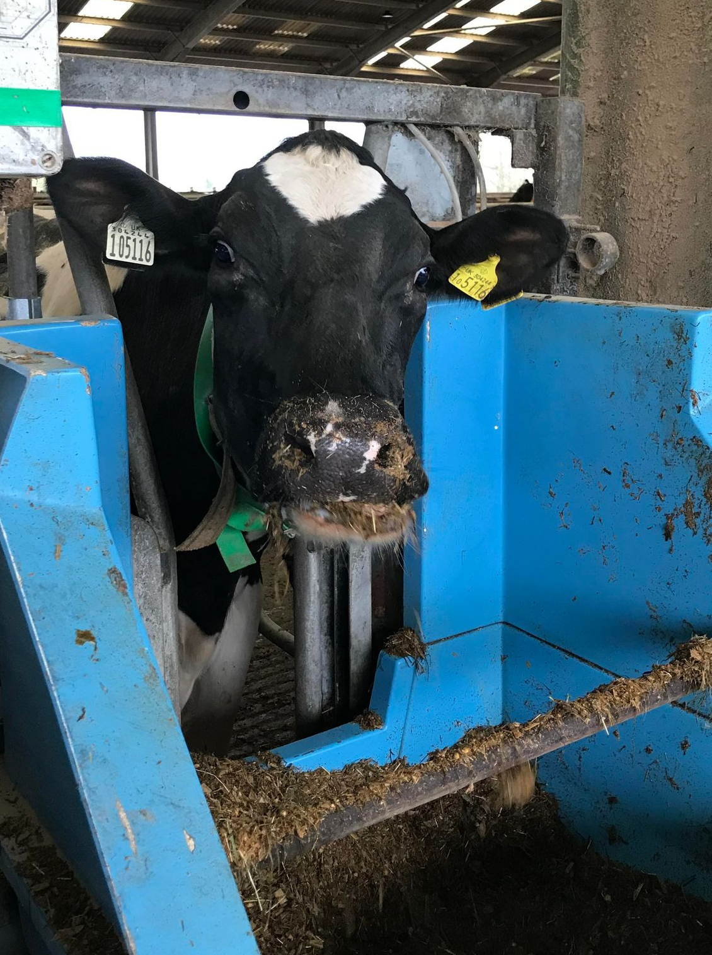

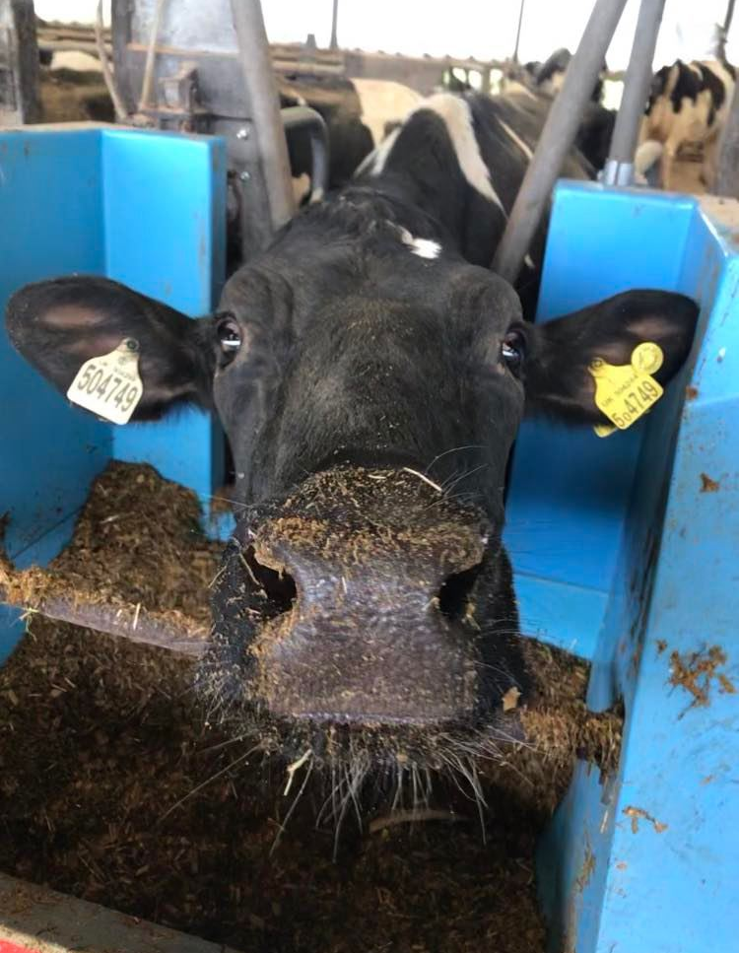
The effect of essential oils supplied in a slow-release rumen bolus on methane production in high yielding dairy cows
By Charlotte Roxborough

Slide 2
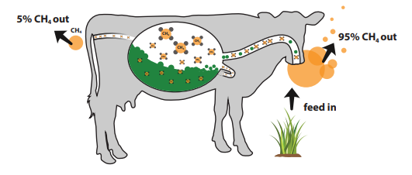
Study objectives
The objectives of this study are to determine the effects of essential oils when supplied in a slow-release rumen bolus on the methane (CH₄) production and performance of high yielding dairy cows.
Image source: Ruark, 2017.

Slide 3
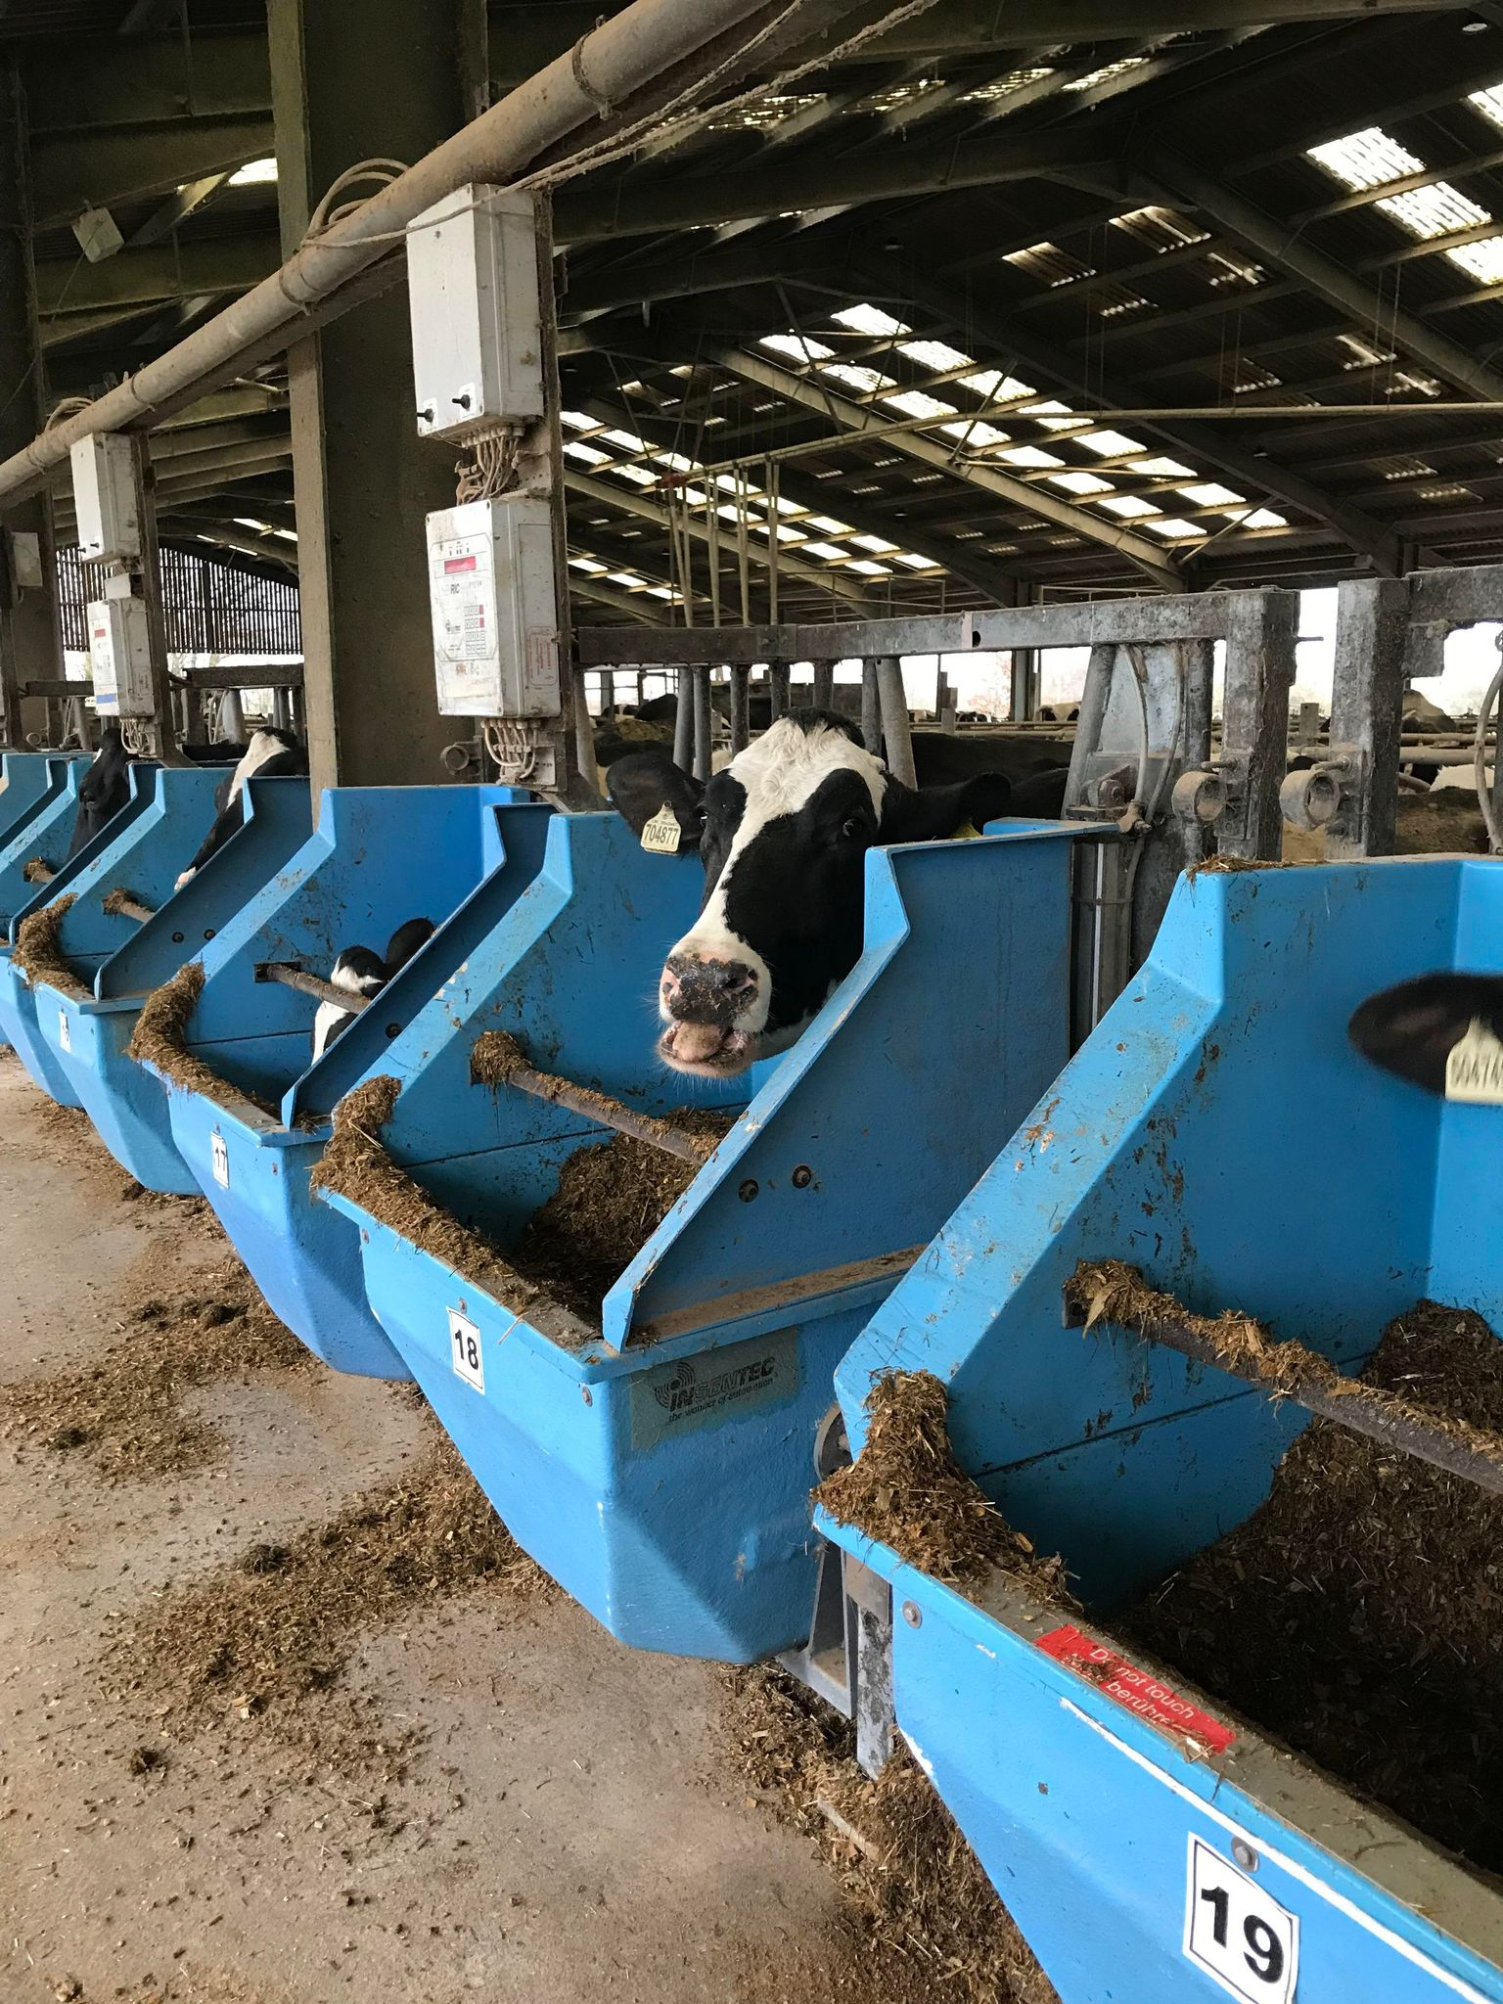
Study design
45 cows.
Three treatments: control group (C), essential oils in feed (TO), essential oils in a bolus (BO).
2-week covariate period where we will measure milk yield, live weight and methane emissions.
The data from the 2-week period will allow us to allocate the cows to treatment, based on the milk yield, live weight, methane emissions and lactation no.

Slide 4
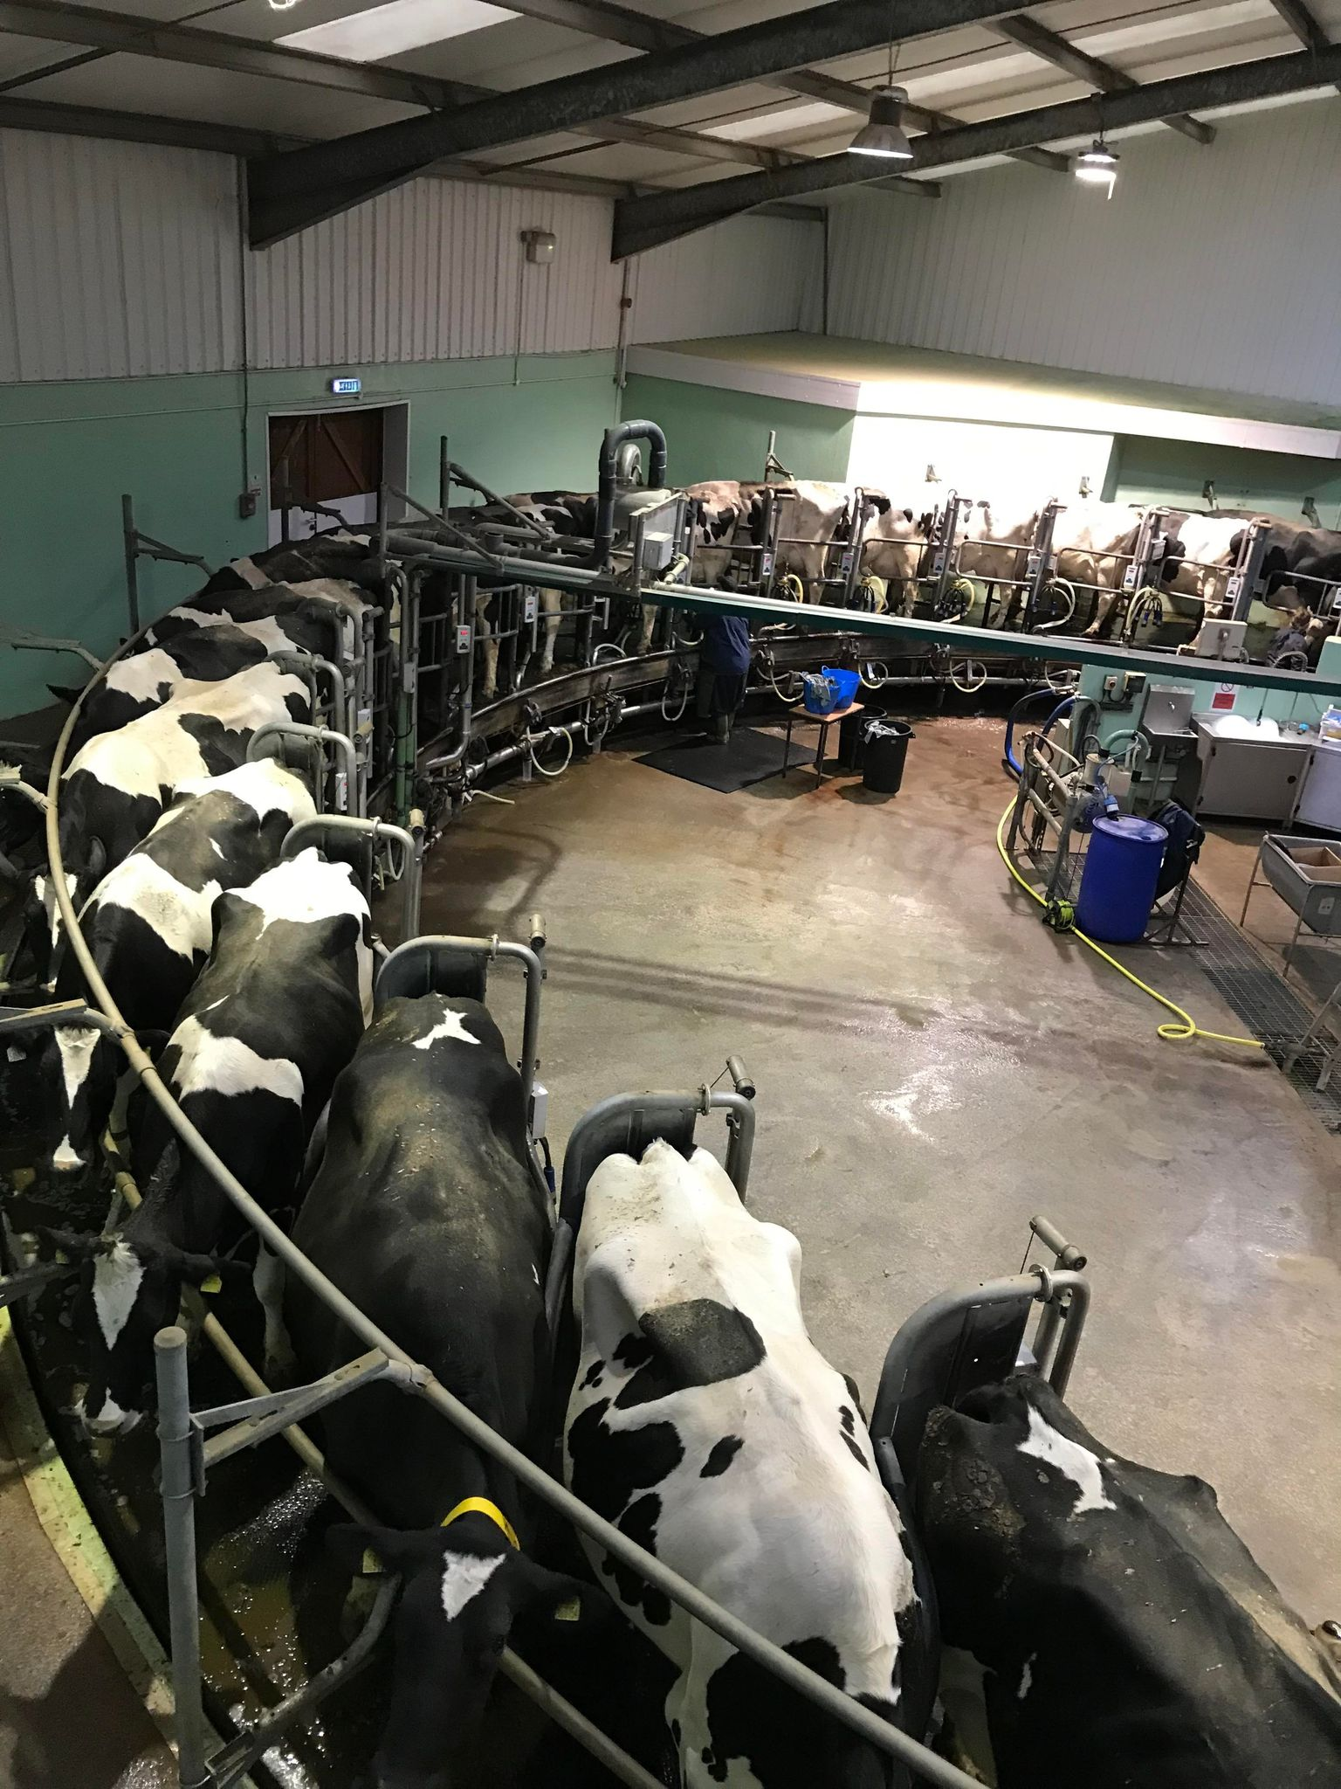
Study design
All of the cows will remain on study for 10 weeks (+ 2-week covariate period).
All 45 cows will be milk sampled weekly, and samples sent for analysis of milk composition.
10 cows per treatment will be blood sampled fortnightly for subsequent analysis.
Live weights and BCS will be collected from all 45 cows fortnightly.
Faecal samples will be collected from 10 cows per treatment in week 8.
Methane measurements will be collected daily from the Greenfeed systems.

Slide 5
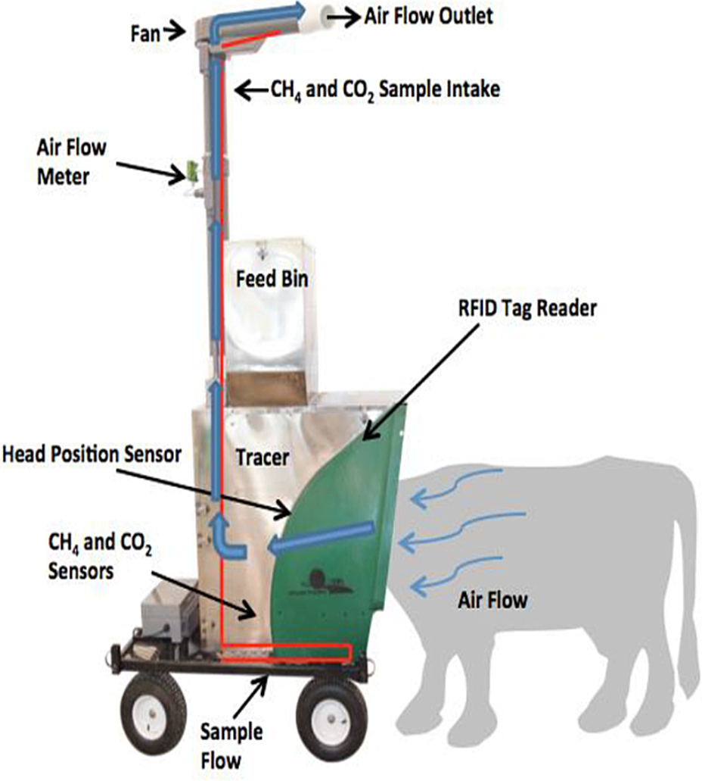
Methane measurements
Methane measurements will be collected via the Greenfeed systems (Zimmerman and Zimmerman, 2011).
Methane measurements are expected to be about 450 g/d (Huhtanen et al., 2019).
Expecting a difference in methane results between treatments of around 15% (Castro-Montoya et al., 2015).
Similar studies investigating methane emissions using Greenfeed systems in dairy cows have found an SEM of around 12 (Silvestre et al., 2022).
Image source: Hristov et al., 2015.

Slide 6
References
Castro-Montoya, J., Peiren, N., Cone, J. W., Zweifel, B., Fievez, V. and De Campeneere, S. (2015) ‘In vivo and In vitro effects of a blend of essential oils on rumen methane mitigation’, Livestock, 180, pp. 134-142.
Huhtanen, P., Ramin, M. and Hristov, A. N. (2019) ‘Enteric methane emission can be reliably measured by the GreenFeed monitoring unit’, Livestock Science, 222, pp. 31-40.
Hristov, A. N., Oh, J., Giallongo, F., Federick, T., Weeks, H., Zimmerman, P. R., Harper, M. T., Hristiva, R. A., Zimmerman, R. S. and Branco, A. F. (2015) ‘The use of an automated system (GreenFeed) to monitor enteric methane and carbon dioxide emissions from ruminant animals’, Journal of Visualized Experiments, (103), e52904. Doi:10.3791/52904.
Ruark, M. D. (2017) Mitigation of enteric methane emissions from dairy cattle.
Silvestre, T., Raisanen, S. E., Cueva, S. F., Wasson, D. E., Lage, C. F. A., Martins, L. F., Wall, E. and Hristov, A. N. (2022) ‘Effects of a combination of Capsicum oleoresin and clove essential oil on metabolic status, lactational performance, and enteric methane emissions in dairy cows’, Journal of Dairy Science, 105(12), pp. 9610-9622.
Zimmerman, P. R. and Zimmerman, R. S. (2011). Method and system for monitoring and reducing ruminant methane production. Patent no. US8307785B2.

